Slide 1


Modern methods of referee teaching/technologies
2009 Symposium for Coaches and Chief Referees 28. – 31. July 2009 Tunis-Gammarth

Slide 2

Modern methods of referee teaching/technologies
Head Sets – Communication on the field
Software Dartfish
Internet Platform – www.dartfish.tv

Slide 3
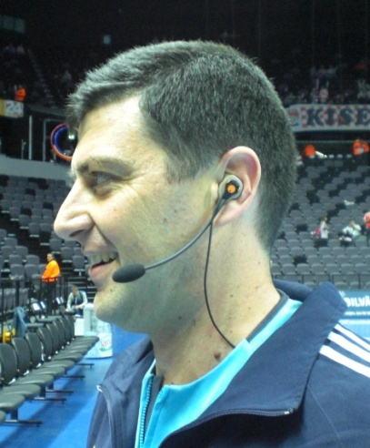
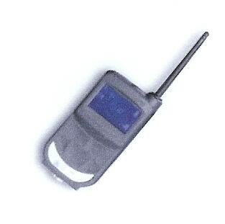
1. Head Set for Referee Communication

Slide 4

Introduction
IHF decided to implement
„head set communication system”
for referees and delegate at WCh 09
Different tests has been executed in SUI, ESP, DEN with positive feedback from everybody
The first real use of the system was at WCh in CRO 09 – with very positive results
The system is the same as used by FIFA/UEFA in the World Cup and in UEFA Champions League

Slide 5
Introduction
It‘s obvious that a personal test in advance by all the nominated referees would have been helpful. But in CRO the referees adapted quit quick to the system – try it at least once in theory room
We are convinced that all the referees will feel comfortable after first test – especially with the customized headset kit

Slide 6
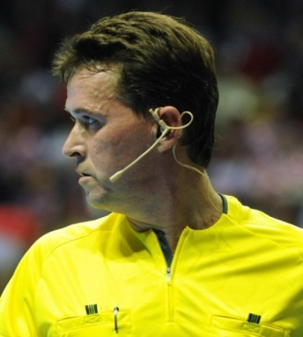
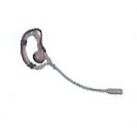
A set consists of:
3 Audio TRX 869 ARF37 (units)
  Nr. 1 and 2 for the referees – Nr 3 for the
  delegate (PRC-Member)
Nr. 1 is the leading unit – in case it does not work, the whole system does not work
Generic Head-Sets with ON/OFF-switch
  1 is for the delegate
  1 is reserve for any problems with customised headset of the referees

Slide 7

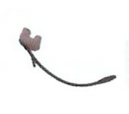

A set consists of:
Customized ear shell – and microphone
  each referee has his own ear shell where the micro can be connected
1 Battery charger 5 Slots with Power Supply
  We will charge 3 ! – 5 comes from football, they need 5 units

Slide 8
A set consists of:
2 armbands
  Try a good and comfortable position
  Armbands– has to be washed daily – hand warm water
  There are harnesses and breast belts available – we focussed for now on armbands and breast belts are available as well

Slide 9
A set consists of:
Earpiece protections for generic head sets
  Because several delegates use the same headset
1 ADIDAS bag for the equipment
ARF37 Wireless Audio Conference System
User guides can be uploaded directly on our web site www.adeunis-rf.com

Slide 10
Setup
We have 3 units (per set) – one for referee A, one for referee B and one for the delegate
We prepare to have per hall at least 2 sets
The referee units are for speak and hear
The delegate unit is only for hear –
but he can switch on to speak –
otherwise there is too much disturbing noise from the
benches and the table

Slide 11
Setup
The referee have the unit in an armband (or
a belt) and it’s covered with the referee shirt. The delegate has his unit in any pocket.
The unit is connected with the headset
with a cable
During the use of the system we do not have to push any button – only to start before the game or to adjust something well in advance. Except on/off speaking by delegate

Slide 12
Setup
The noise level of whistling and external notice is dimmed down – there is the possibility to change the volume level – not during the game
If you have problems while using the system – don‘t let you disturb – solve it in the half time break or before the next match.

Slide 13
Referee using:
To agree on the moment of warning signal for passive play
To agree on the moment of changing positions
To agree on hard punishments like Red Cards
To help the partner to focus on the right things (e.g. focus on 6m line etc.)
To hear verbal warnings of the partner towards players and benches

Slide 14
Referee using:
To hear verbal warnings of the delegate towards the benches – only if it is turned on
To announce to each other a number of a player to be punished when giving advantage
To hear the whistle of the partner and the delegate through the headset when the noise in the hall is big
Any other unexpected situation, where one can help each other
To motivate the partner to keep concentration

Slide 15

Referee using:
The communication between the referees can be in your own language, because the purpose is generally NOT to share your communication within the couple with the delegate.
But in case there is something to inform or to ask the Delegate it has to be in English.
Start with using the system rarely – use it only, when it helps to do your job as a referee better/easier.

Slide 16
Referee using:
Don’t use it:
To give advice to partner for decisions in his field of responsibility
To discus past right or wrong decisions
To disturb concentration of your partner (and yourself) with tips and hints and questions
To speak about other things

Slide 17
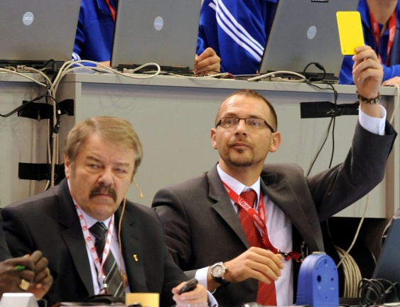
Delegate using:
The delegate never speaks to the
referees about any factual decision.
The delegate uses the system towards the referees very rarely – it could be for example :
  in case of clear rule mistake to prevent a protest
  to give a hint, if the ball was in play or out of play, so that you are sure how to restart the game after the time-out, when the game was interrupted from the table

Slide 18
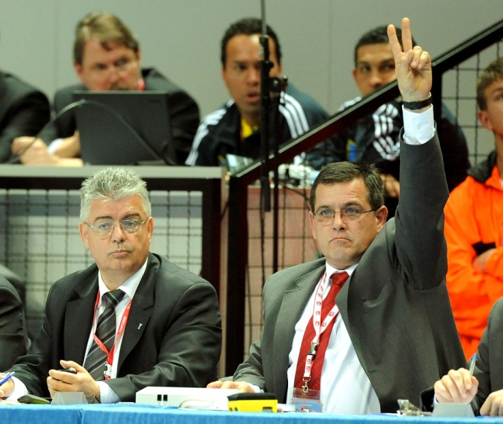
Delegate using:
  to ask the referee to come to the table to clarify something
  to get the attention of the referees if they didn’t hear the whistle of the table.
  to give a ‘count-down’ the last
  10 seconds, to help the referees
  know that time is expiring and to
  know how much time is left
  without focusing on scoreboard

Slide 19
good luck with the communication system

Slide 20
2. Software Dartfish

Slide 21

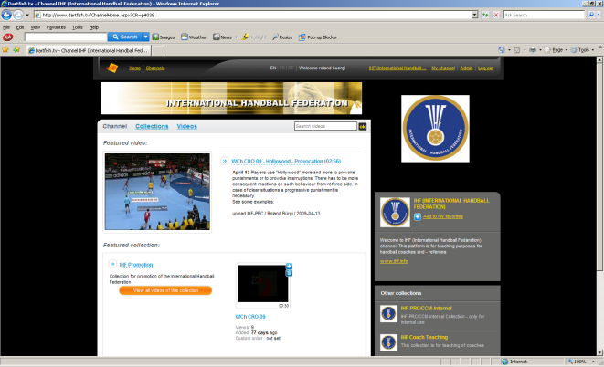
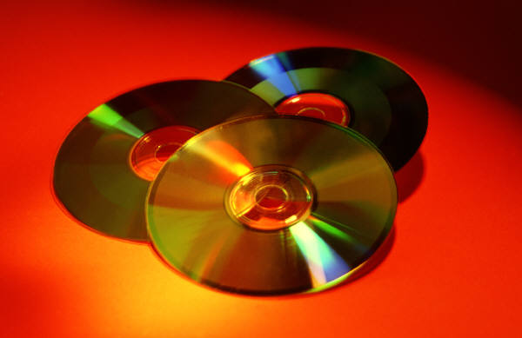

Dartfish TeamPro 5.0
Beamer
Tagging
Publishing
Analysing
www.dartfish.tv
CD/DVD
C
Tagging live /
Tagging Video Clip
E-Mail
Stick or external disk

Slide 22

Tagging
Making marks – defining “events”
Describing events
Evaluating events
Presenting events (time, topic)
Event 1
Event 2
Two files will be created:
movie.avi (file you have loaded to your computer –
large file of whole match – 2-3 GB von DVD)
movie.avi.dartclip (this file contains all the Event information)

Slide 23
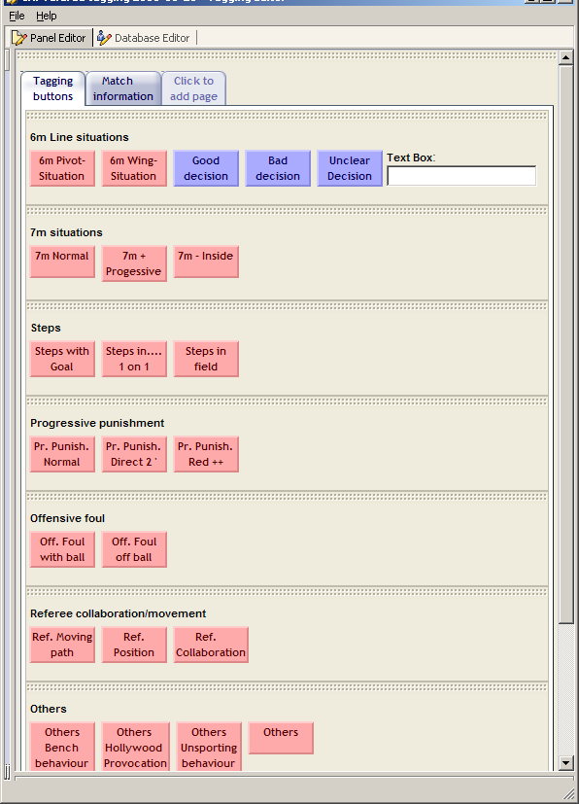
Tagging
Tagging
Event 1
Event 2
Tagging Video Clip

Slide 24
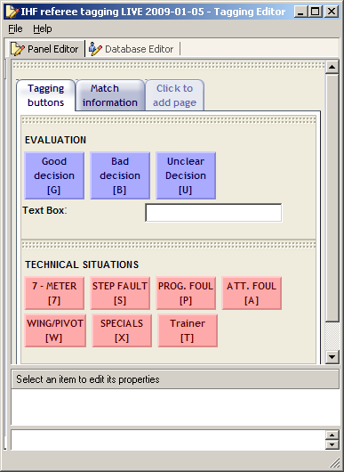
Tagging
Event 1
Event 2
Tagging live

Slide 25
Analysing / Publishing
Event 2
Event X
Selecting interesting material (events) for teaching.
Event 1
Presentation
according to criteria like:
time
topic
right/wrong
etc.
Creating single clips (1 event = 1 clip; 2 files).
Description
Key position
Graphics
etc

Slide 26
Analysing / Publishing
present it with beamer on screen
save it on my computer
on a stick/external disk
burning on a CD/DVD
send it by E-Mail (big!!)
upload it to platform
Single clips with additional information

Slide 27
Live Demo
How to prepare „events“
Publish some of the events to clips
Analyse one of it – save a presentation
For free test version downloads see www.dartfish.com (including dartfish viewer)

Slide 28
3. Dartfish.tv

Slide 29
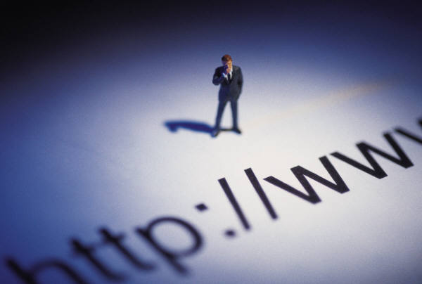
3. Dartfish.tv
There are two collections available for the moment for you:
a public collection (everybody can see it)
a collection for IHF-referees / lecturers
and national chief referees

Slide 30
3. Dartfish.tv
Collections for Refereeing
Experts
PRC/CCM
Open
IHF-
Refs
Lecturer
Chief Refs
Test open
Public
Test open

Slide 31
http://www.dartfish.tv/Login.aspx
Interesting (also funny) clips are
welcome – with your comments
(PRC/CCM will comment as well if
necessary)
it’s foreseen to teach/prepare
our referees more over the web
- video analyse of matches
- studying interpretations of PRC
- etc.

Slide 32
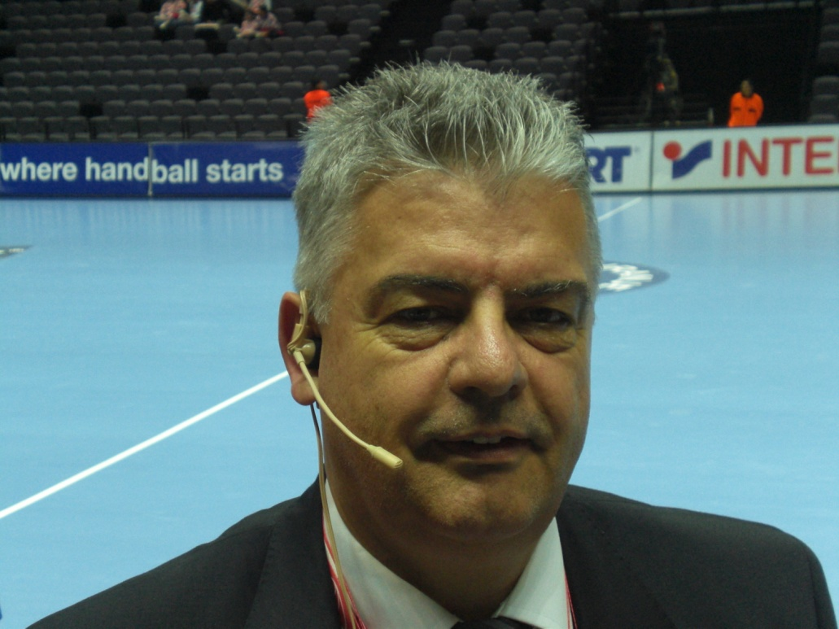
Thank you for your attention
IHF-PRC / Roland Bürgi

